Slide 1

DEPARTMENT OF COMPUTER SCIENCE & ENGINEERING (Accredited by NBA) MANGALORE INSTITUTE OF TECHNOLOGY & ENGINEERING (A Unit of Rajalaxmi Education Trust®, Mangalore) Autonomous Institute affiliated to V.T.U, Belagavi, Approved by AICTE, New Delhi Accredited by NAAC with A+ Grade & ISO9001:2015 Certified Institution
Internship Presentation
On
“ARTIFICIAL INTELLIGENCE AND MACHINE LEARNING”
By
TEJASWINI PEERU GOUDA
4MT20CS170
Under the Guidance of
Ms. MEDHINI B V
Robotics & Design Engineer
DLithe, Bangalore

Slide 2


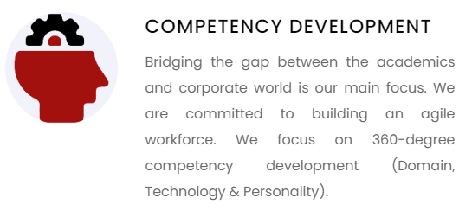

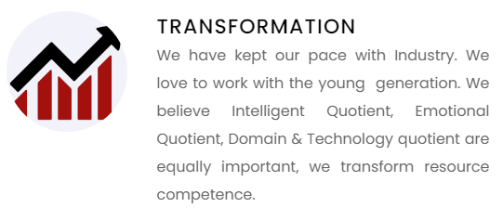
ABOUT COMPANY
Company: DLithe Consultancy Services Pvt. Ltd
Founder: Arun Rajpurohit
DLithe is an EdTech company serving IT Companies and Academic Institutions, since the year 2018. With experiences drawn from corporate time, the foundation of DLithe is built to innovate products that transform the upcoming generation.

Slide 3
WEEKLY OVERVIEW OF INTERNSHIP ACTIVITY
Week 1
Objective:
Understanding Python Fundamentals for AI & ML.
Activities:
Covered Python syntax and data structures.
Explored essential libraries used in AI and ML.
Worked on basic Python programming exercises and projects.

Slide 4
Week 2
Objective:
Learning Various Machine Learning Algorithms and Implementation in Python.
Activities:
Hands-on implementation of Binary Classification algorithms.
Worked on Linear Regression and its use cases.
Explored Decision Trees and their practical applications.
Applied CNN on MNIST dataset for image classification.
Understood concepts of Forward Propagation and Neural Networks.

Slide 5
Week 3
Objective:
Use Case Selection, Data Collection, Preprocessing, and Algorithm Exploration.
Activities:
Dataset: Created dataset with over 1000 samples of hand-written digits.
Preprocessing: Pre-processed the data to remove null values, and further found ways to annotate data.
Discussed potential challenges and approaches with the mentor during weekly sessions.

Slide 6
Week 4
Objective:
Model Training, Testing, Sentiment Analysis, Interface Development and Deployment.
Activities:
Training: Trained the model using dataset.
Model Evaluation: Evaluated the trained model on the test set to assess its performance, calculating metrics such as accuracy and precision.
Web Application Development and Deployment: By utilizing Streamlit, the model was successfully integrated with the web application.

Slide 7
HANDWRITTEN DIGIT RECOGNITION
Handwritten digit recognition is crucial in the digital age for converting handwritten characters into machine-readable formats, aiding applications like license plate recognition.
Convolutional neural networks (CNNs), a type of deep neural architecture, excel over shallow neural networks in this domain. CNNs are widely used in image classification, object recognition, recommendation systems, signal processing, natural language processing, computer vision, and face recognition, offering significant advantages in handwriting recognition technology.

Slide 8
PROBLEM STATEMENT
The problem of handwritten digit recognition aims to develop a machine learning model that can accurately identify and classify digits from 0 to 9 in handwritten images.
This technology addresses common real-world issues such as:
Recognizing numbers on license plates.
Automating postal mail sorting.
Streamlining bank check processing.
Digitizing handwritten documents.

Slide 9
OBJECTIVE
Develop a Recognition Model: Create a machine learning model that can accurately identify handwritten digits from 0 to 9.
Achieve High Accuracy: Ensure the model performs with high accuracy in recognizing and classifying digits.
Optimize for Efficiency: Design the model to be computationally efficient for quick and reliable digit recognition.
Handle Diverse Handwriting Styles: Train the model to recognize digits written in various handwriting styles and conditions.
Enable Practical Applications: Implement the model to support practical applications.

Slide 10
METHODLOGY
Importing libraries: Libraries are useful tools that can make a web developer's job more efficient. It's a set of prewritten code, that we can call while programming the code.
Data Collection and Preprocessing: Created a dataset of 1000 handwritten digit images. Preprocessed the images by resizing them to a consistent size (64x64), converting them to grayscale, and normalizing the pixel values.
Model Architecture: Designed a CNN architecture for handwritten digit recognition.

Slide 11
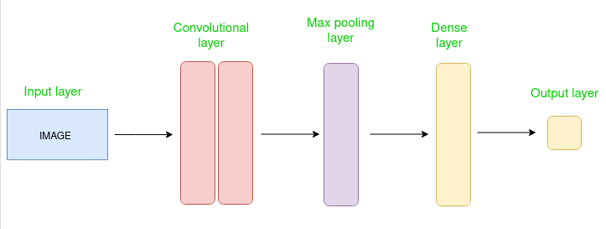
The CNN architecture includes the following layers:
Convolutional layer: This layer extracts low-level features from the input image.

Slide 12
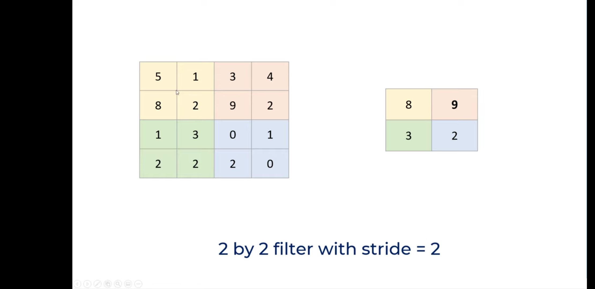
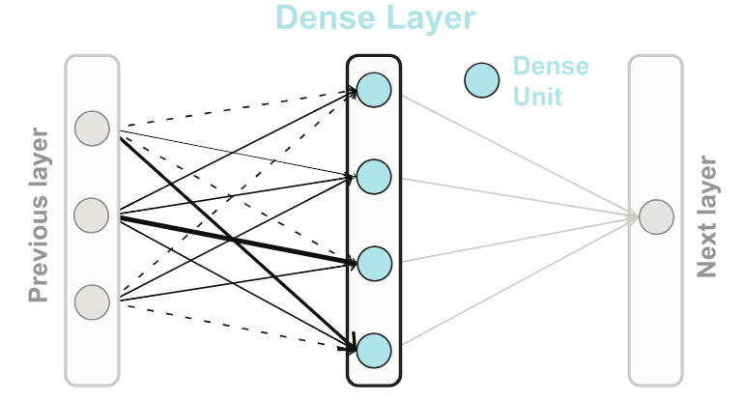
Max pooling layer: This layer reduces the dimensionality of the feature maps while preserving important information.
Flatten layer: This layer converts the feature maps from a 2D to 1D format.
Dense layer: This layer combines the high-level features extracted from the previous layers and outputs a probability distribution over the 10 digit classes.

Slide 13
Training the Model: We are training the model using 2 dense layers, which combines to form a full connected layer. We flatten the pixels of the greyscale image in the input layer.
Testing the Model: Once the model is trained, we can use the loss function and accuracy function to test the model. We used “ADAM” as our optimizer, “cross-entropy” as our loss and “accuracy” as our metrics.
Getting the output: We took a set of inputs and upload them into our model. Then we use a while loop to analyze each input individually and give the predictions for each image.

Slide 14
IMPLEMENTATION
Dataset Creation: The dataset will be in the form of collection of hand written digit images.
Data Preprocessing: The collection of images will be preprocessed and converted into binary matrix which represents the corresponding image.
Model Creation: It includes designing the CNN architecture and configuring the model with appropriate activation functions like ReLU, layers, and output units.
Model Training :The CNN model is trained on the training set, validating it on a separate validation set.

Slide 15
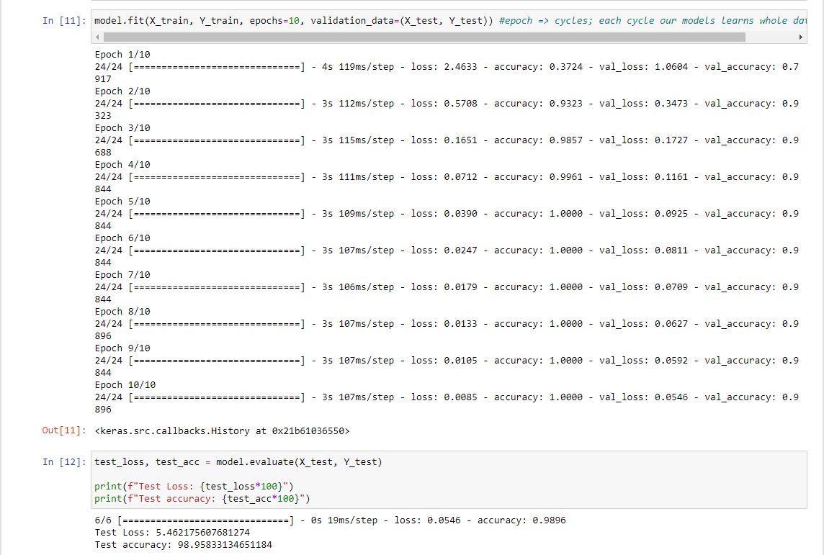
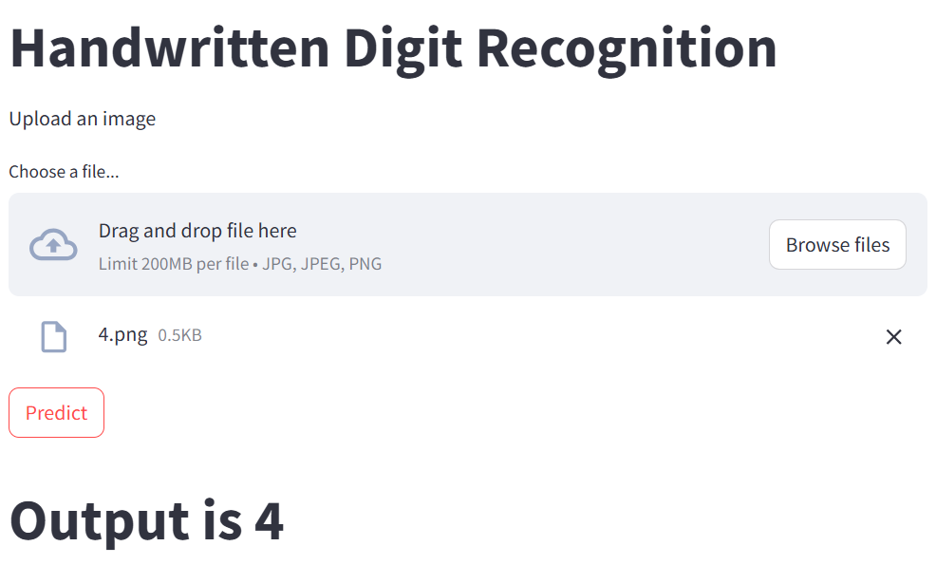
Model Evaluation: Evaluating the trained model on the test set to assess its performance, calculating metrics such as accuracy and precision.
Web Application Development and Deployment: By utilizing Streamlit, the model was successfully integrated with the web application.

Slide 16
CONCLUSION
In conclusion, this implementation effectively digitizes handwritten digits by analyzing and predicting their values using a neural network. The system saves images from MS Paint, processes them, and predicts their values using a trained model. By leveraging a Sequential Model with ReLU and SoftMax activations, optimized by the Adam algorithm, and evaluated using Cross-Entropy and Accuracy functions, it accurately recognizes and digitalizes handwritten data. This demonstrates a successful application of neural networks for image recognition, showcasing a comprehensive understanding and application of key machine learning concepts and techniques.

Slide 17
THANK YOU

